Slide 1

WELCOME
COHORT 5
7th Sept – 3rd Dec 2026
Suite 6-6-7, Level 6, Menara MAA

Slide 2
Introduction to PostgreSQL
PostgreSQL is a powerful, open-source object-relational database system (ORDBMS) known for its reliability, data integrity, and advanced features.
Key features:
Object-Relational
SQL Standard Compliance
Data Integrity
Concurrency Control
Open Source

Slide 3
Setup PostgreSQL
Link: https://www.postgresql.org/download/
During installation, create a password for your database when requested.

Slide 4
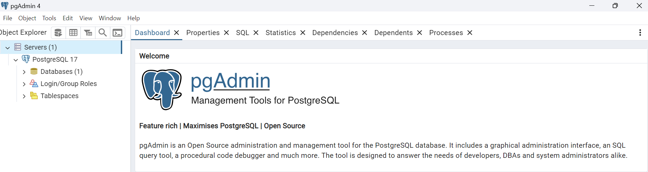
Setup PostgreSQL
Open pgAdmin 4 after installation and refer to the following UI:

Slide 5
Adding a new server
Right-click on 'Servers' in the left panel
Select 'Register' → 'Server'
In the 'General' tab:
  Name: Give your server a name (e.g., "LocalPostgres")
In the 'Connection' tab:
  Host: localhost
  Port: 5432
  Maintenance database: postgres
  Username: postgres
  Password: [your PostgreSQL password]
  Save password: Check this box

Slide 6
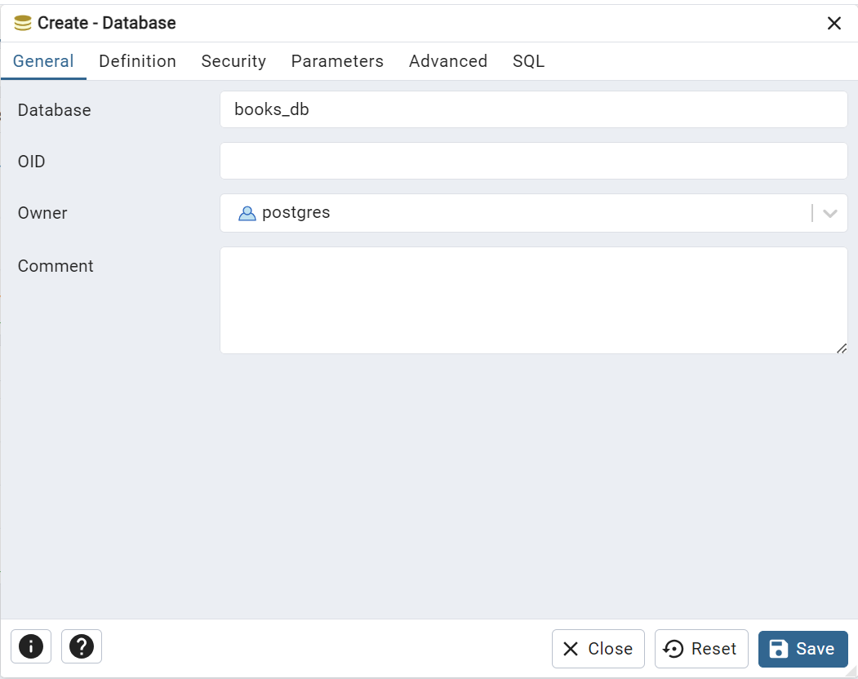
PostgreSQL (localhost)
Right click Databases > Create > Database…
Create a database name books_db
Click the Save button

Slide 7
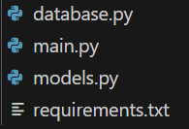
PostgreSQL (localhost)
Create a new folder
In the new folder, create four new files with the following name:
  database.py
  main.py
  models.py
  requirements.txt

Slide 8
PostgreSQL (localhost)
Installation and setup:
Include the following packages in the requirements.txt:
  fastapi[standard]
  uvicorn[standard]
  sqlalchemy
  psycopg2
  python-dotenv
pip install -r requirements.txt

Slide 9
PostgreSQL (localhost)
What is psycopg2 and SQLAlchemy ?
Psycopg2 is a database adapter for the Python programming language that allows Python applications to connect to and interact with PostgreSQL databases, executing SQL queries, and work with data.
SQLAlchemy is the Python SQL toolkit and Object Relational Mapper that gives application developers the full power and flexibility of SQL.

Slide 10
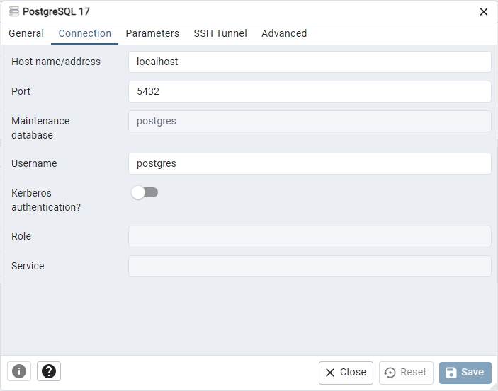
PostgreSQL (localhost)
Database.py: (Connection details)
In pgAdmin 4: Right click PostgreSQL 17 > Properties > Connection

Slide 11
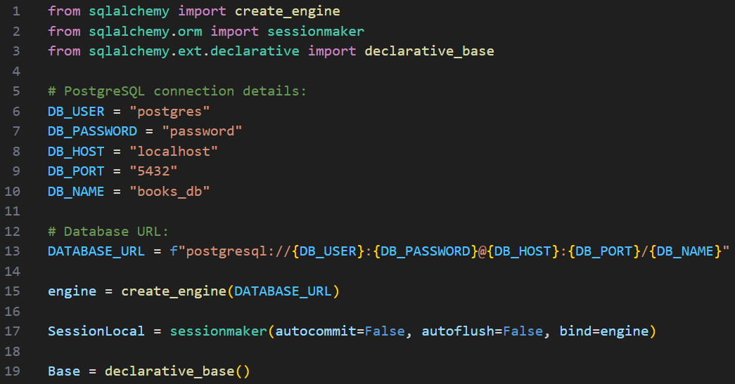
PostgreSQL (localhost)
Database.py:

Slide 12
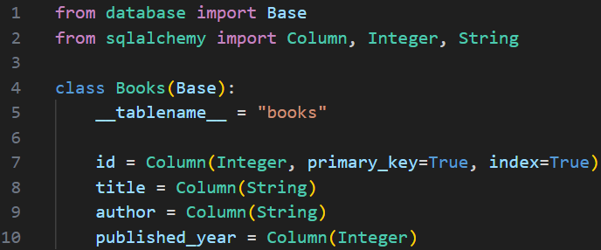
PostgreSQL (localhost)
models.py:

Slide 13
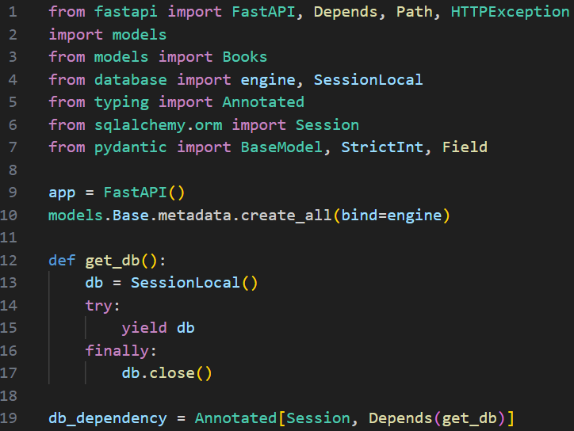
PostgreSQL (localhost)
main.py:

Slide 14
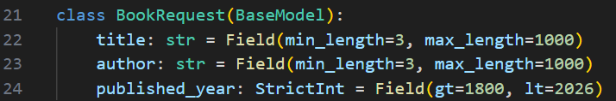
PostgreSQL (localhost)
main.py (continue):

Slide 15
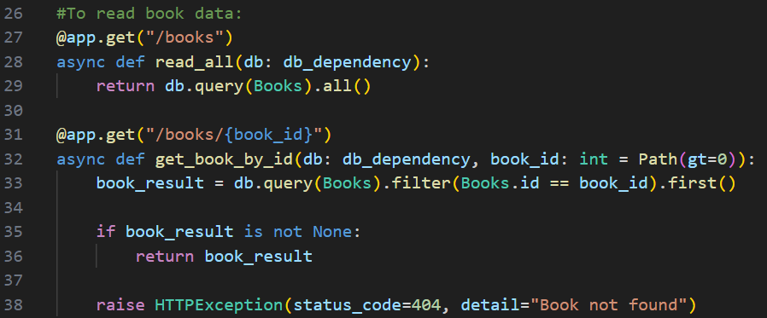
PostgreSQL (localhost)
main.py (continue):

Slide 16
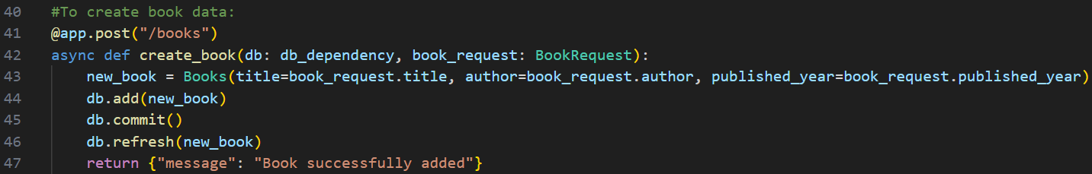
PostgreSQL (localhost)
main.py (continue):

Slide 17
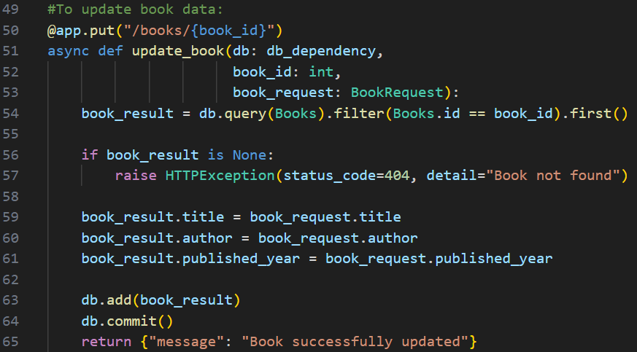
PostgreSQL (localhost)
main.py (continue):

Slide 18
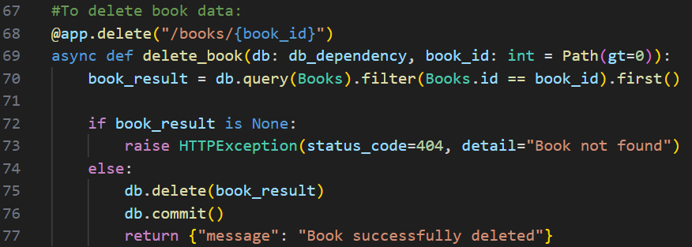
PostgreSQL (localhost)
main.py (end):

Slide 19
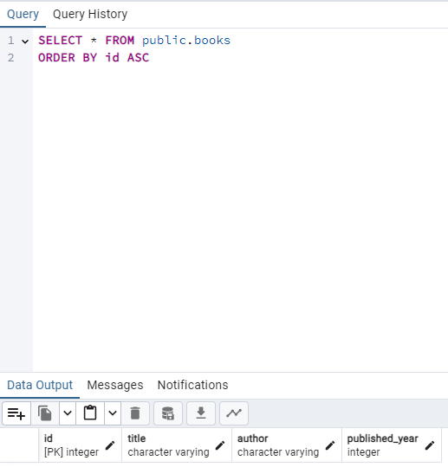
PostgreSQL (localhost)
main.py:
Run uvicorn as follows: uvicorn main:app --reload
Created table location:
books_db > Schemas > Tables > books
To view rows:
Right click books > View/Edit Data > All Rows

Slide 20
PostgreSQL (localhost)
models.py defines the Books class:
The Books class specifies the columns and their data types for the books table
main.py creates the tables:
The line models.Base.metadata.create_all(bind=engine) in main.py tells SQLAlchemy to create the tables based on the models defined in models.py. This line is executed when the FastAPI application starts.
The models.py file acts as a blueprint for the books table. SQLAlchemy uses this blueprint to create the actual table in PostgreSQL database.

Slide 21
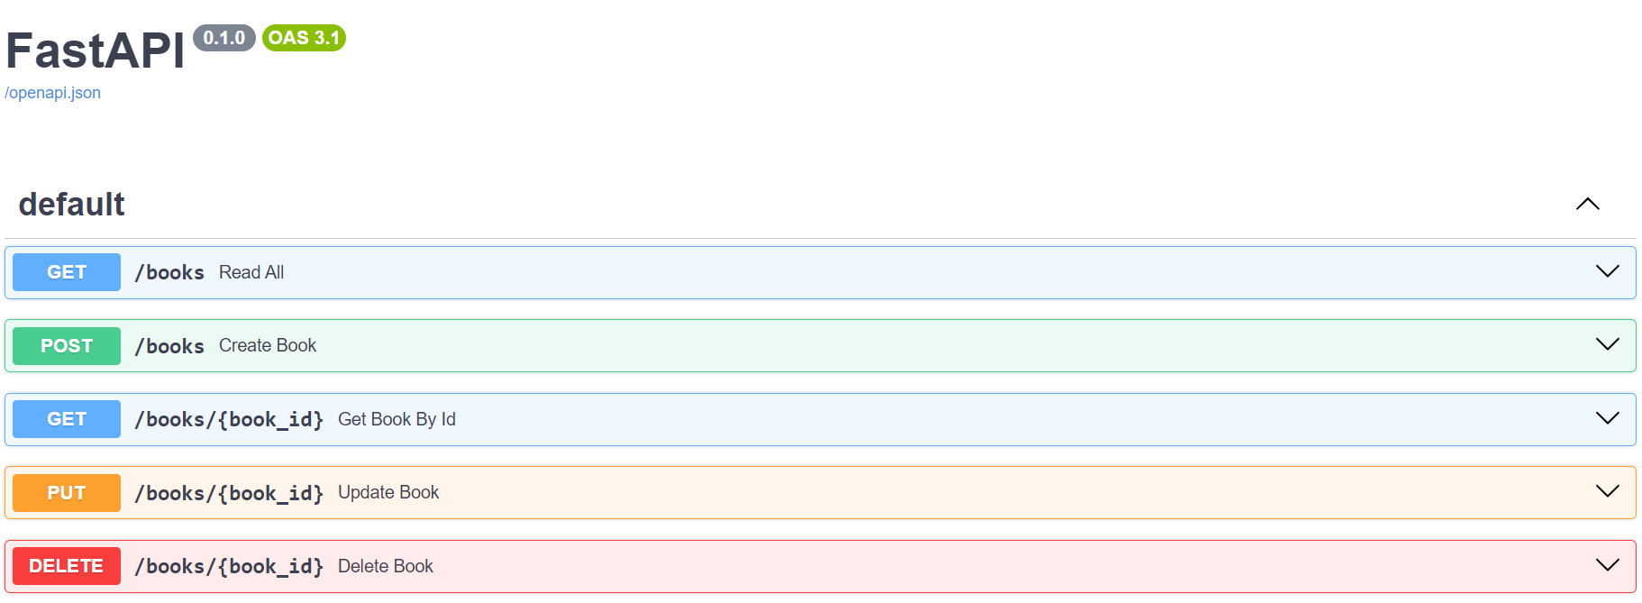
PostgreSQL (localhost)

Slide 22
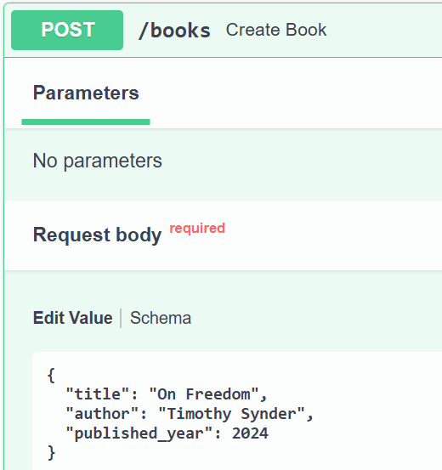
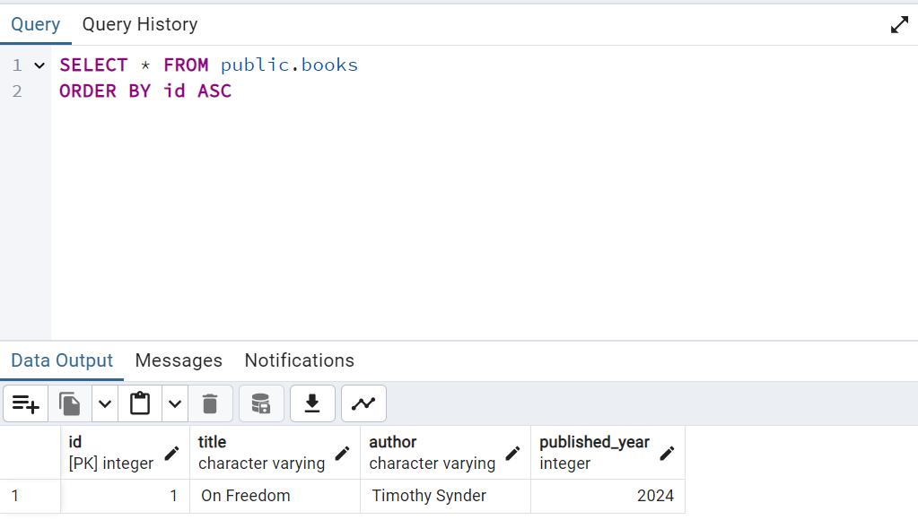
PostgreSQL (Create)

Slide 23
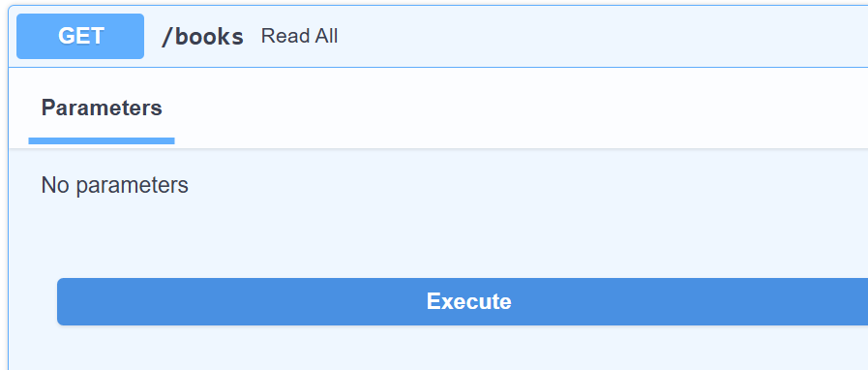
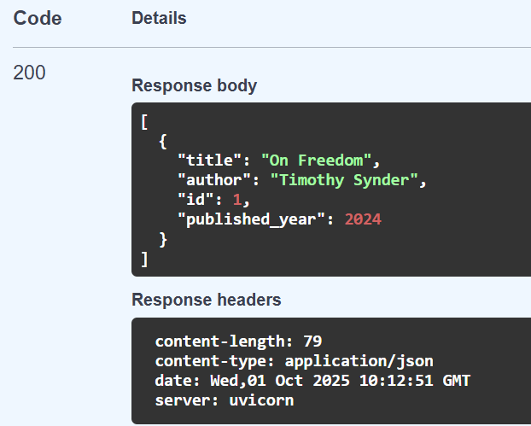
PostgreSQL (Read)

Slide 24
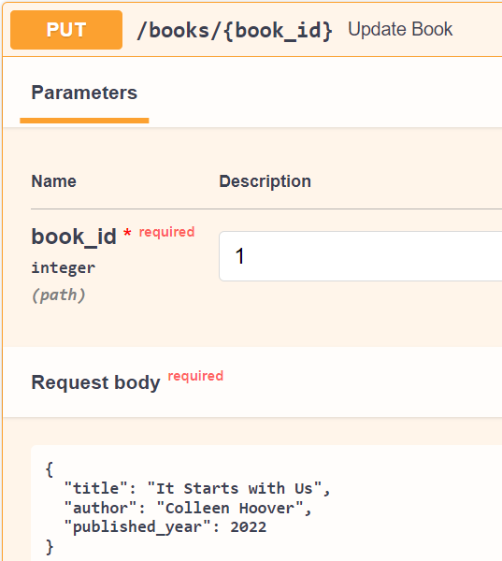
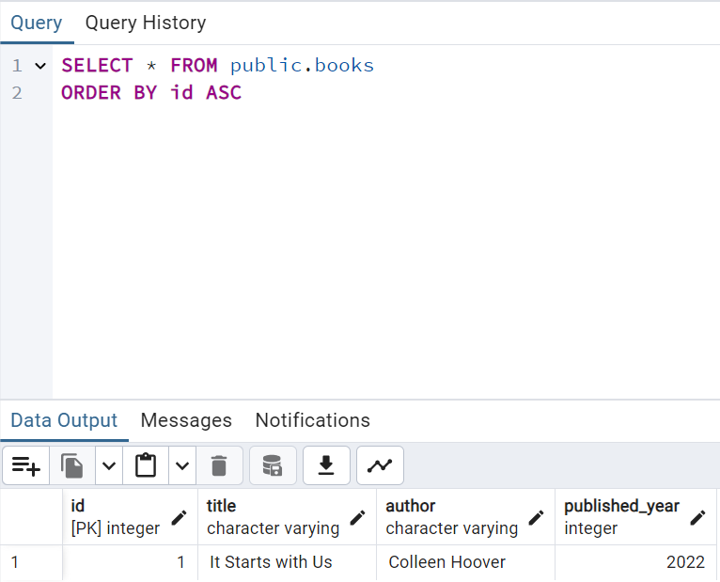
PostgreSQL (Update)

Slide 25
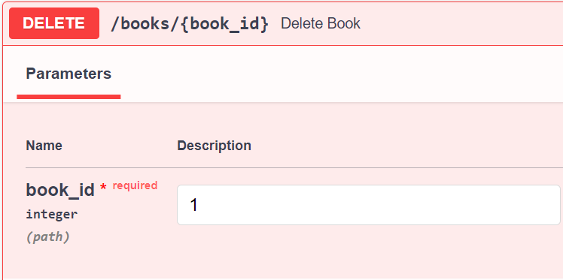
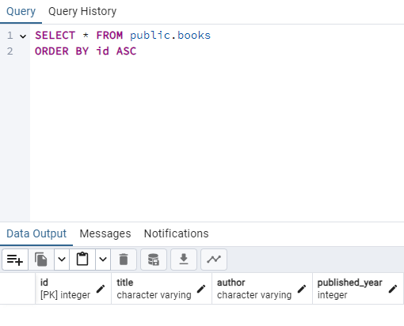
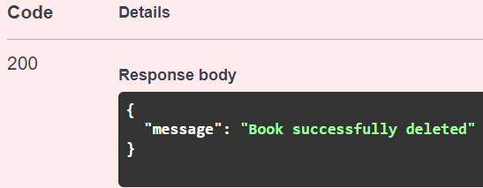
PostgreSQL (Delete)

Slide 26
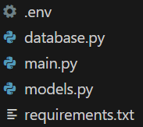
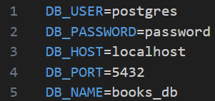
PostgreSQL (localhost)
Connection pooling and environment variables:
Create a file with .env extension and add the credentials:

Slide 27
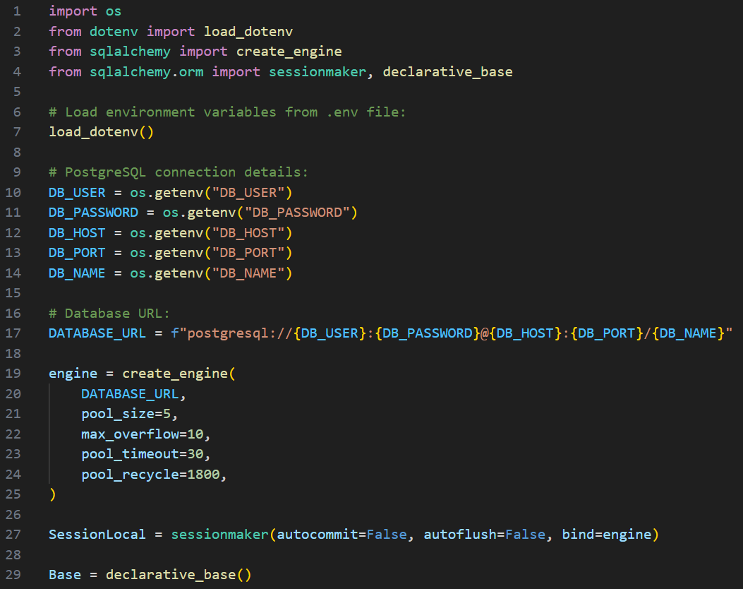
PostgreSQL (localhost)
Add connection pooling and environment variables to database.py:

Slide 28
PostgreSQL (localhost)
Connection pooling:
Performance:
  pool_size=5: This sets the number of connections to keep open in the pool. When a request comes in, it can immediately use one of these connections instead of creating a new one.
Scalability:
  max_overflow=10: If all connections in the pool are in use, this allows creating up to 10 additional temporary connections. This helps handle sudden spikes in traffic.
Reliability:
  pool_timeout=30: If a connection can't be obtained from the pool within 30 seconds, it raises an exception. This prevents requests from hanging indefinitely.
Stability:
  pool_recycle=1800: This recycles connections after 30 minutes (1800 seconds). Some databases or network setups may close idle connections, so recycling helps ensure you're not trying to use a stale connection.

Slide 29
PostgreSQL (Exercise)
Develop a database to store your to-do list items and implement CRUD (Create, Read, Update, Delete) endpoints to communicate with your to-do list database.

